Slide 1
Lecture 06: Dimension
Chris Walshaw
Computing & Mathematical Sciences
University of Greenwich

Slide 2
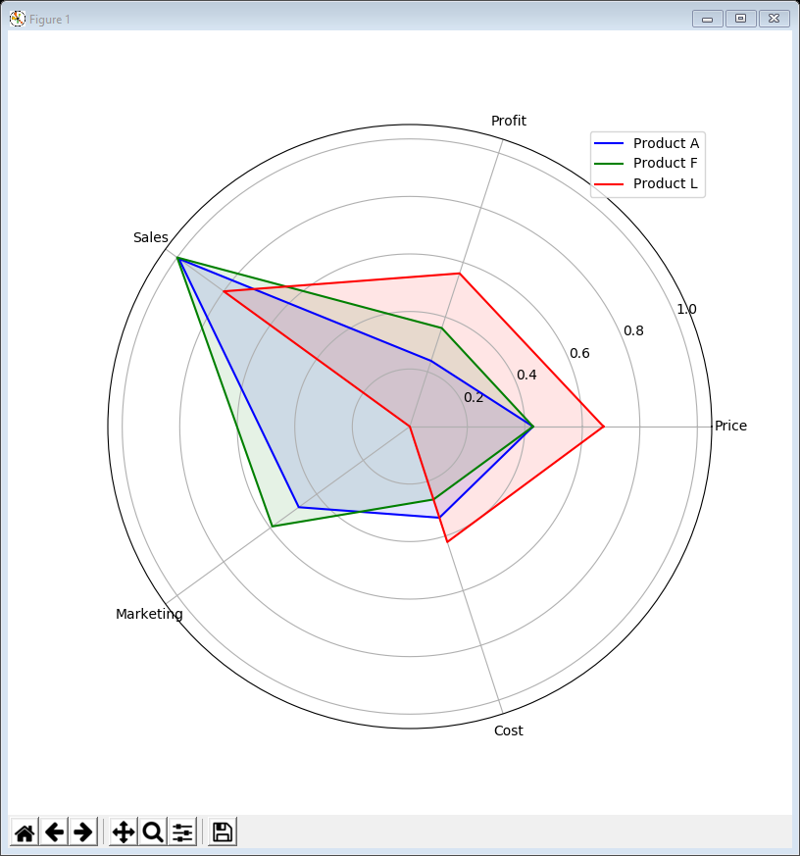
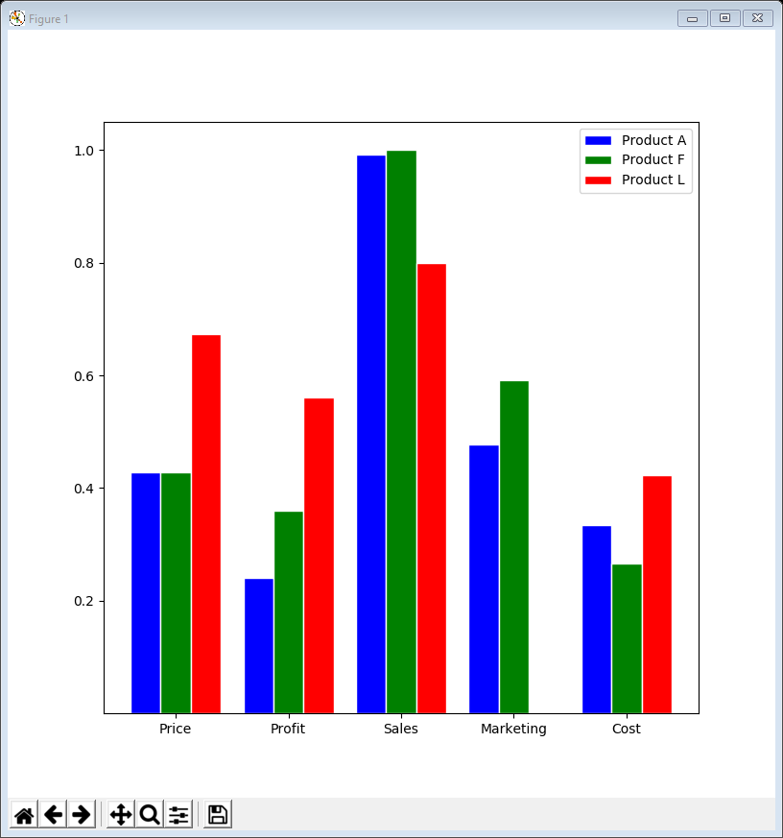
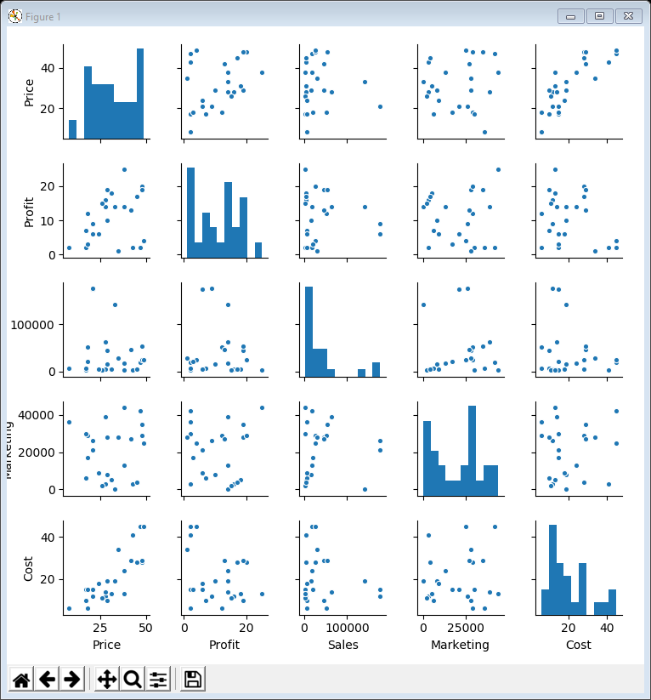
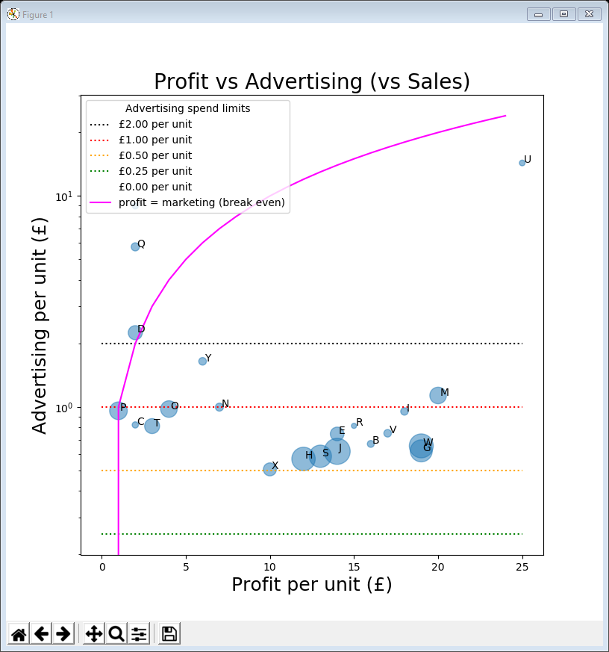
Motivation / Objectives
The company who supplied the data want to know about products that
don’t sell well or
aren’t very profitable or
cost too much to market or …
Last week we looked at distribution, deviation & outliers with a particular focus on seasonality
some products exhibited quarterly or weekly seasonality
also looked at outliers when comparing marketing with sales
We will investigate these outliers by focusing on the summary data (price / cost / profit / marketing) introduced earlier using
comparative bar charts
radar / spider plots
correlograms / pair plots
bubble plots

Slide 3
Common features
Most of today’s examples contain the same lines of code at the top
import the libraries (same as last week)
read in the daily sales & product data and construct the summary data
We will explore this summary data
contains 5 attributes / variables / columns (Price, Profit, Sales, Marketing, Cost) each with 25 data points / rows (one for each product)
data = pd.read_csv('https://tinyurl.com/ChrisCoDV/Products/DailySales.csv', index_col=0)
marketing_data = pd.read_csv('https://tinyurl.com/ChrisCoDV/Products/MarketingPerProduct.csv',
index_col=0)
price_per_unit = pd.read_csv('https://tinyurl.com/ChrisCoDV/Products/PricePerUnit.csv',
index_col=0)
profit_per_unit = pd.read_csv('https://tinyurl.com/ChrisCoDV/Products/ProfitPerUnit.csv',
index_col=0)
summary_data = pd.DataFrame(index=data.columns)
summary_data['Price'] = price_per_unit.values
summary_data['Profit'] = profit_per_unit.values
summary_data['Sales'] = data.sum().values
summary_data['Marketing'] = marketing_data.values
summary_data['Cost'] = summary_data['Price'] - summary_data['Profit']
print(summary_data.head())

Slide 4
Dimension?
Dimension essentially describes the number of variables
The summary data has dimension 5
5 attributes / variables / columns (Price, Profit, Sales, Marketing, Cost)
The daily sales data has dimension 25
25 products / variables / columns (A, B, … Y)
however in many ways it is easier to make comparisons as all variables are measuring the same thing (sales per day)

Slide 5
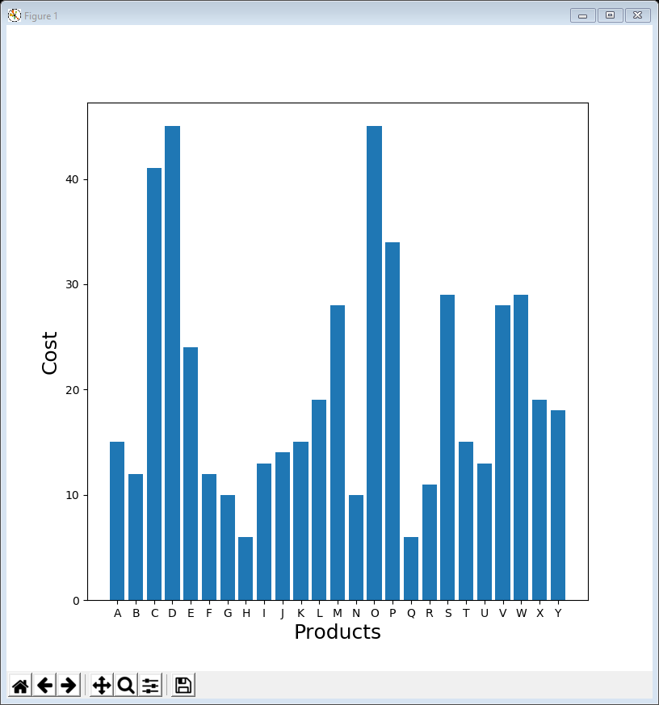
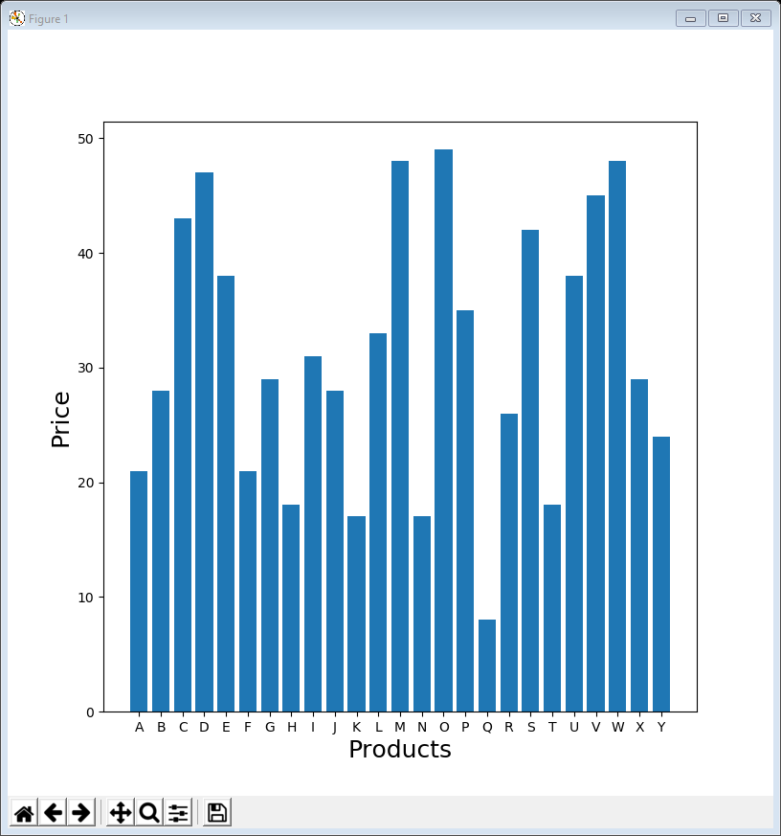
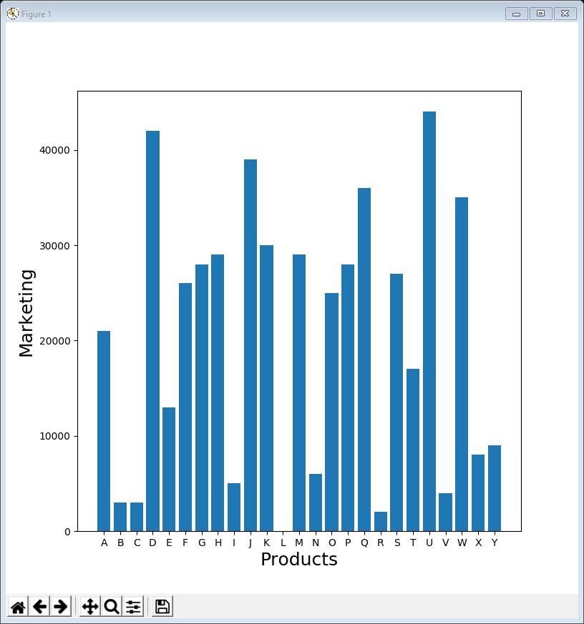
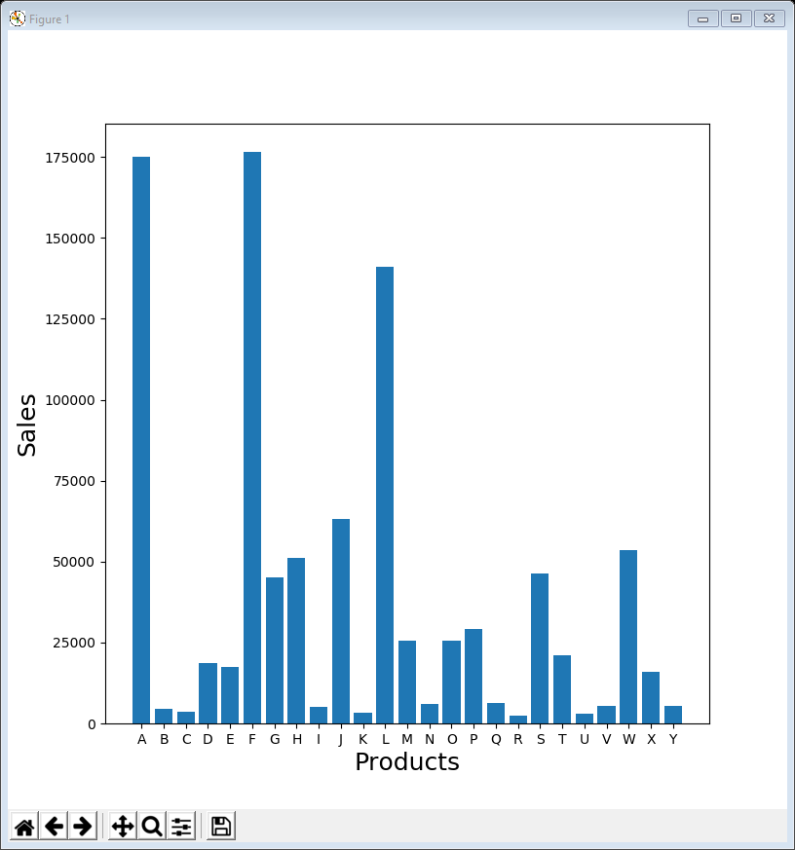
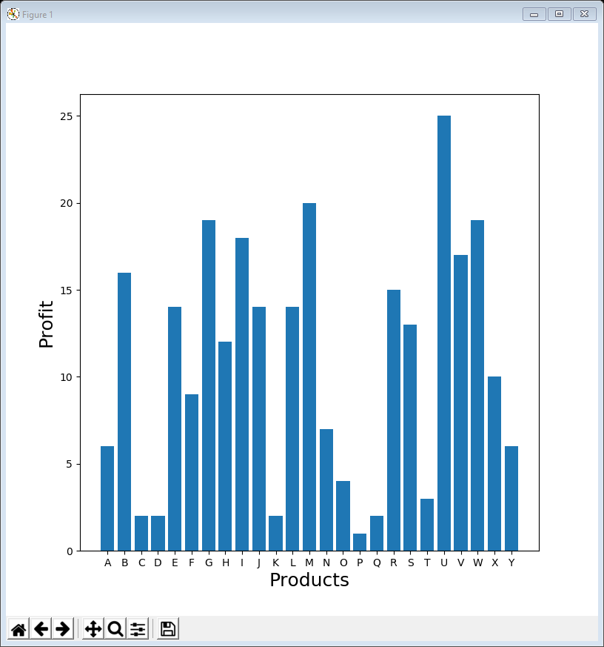
01BarChart all attributes.py
First let’s draw a bar chart of each attribute (Price, Profit, …)
The single line in bold actually creates the bar charts
We use NumPy to calculate positions (x_pos) for the bars / tick marks on the x-axis because the summary data index has no numerical value
it’s just product names (A, B, C, …)
we also did this in lecture 02 but didn’t need to when the index was dates
Although each plot tells us about a particular variable, it’s almost impossible to see how the variables impact on each other (if they do at all)
for attribute in summary_data:
plt.figure(figsize=(8, 8))
x_pos = np.arange(len(summary_data.index))
plt.bar(x_pos, summary_data[attribute],
align='center')
plt.xticks(x_pos, summary_data.index)
plt.xlabel('Products', fontsize=18)
plt.ylabel(attribute, fontsize=18)
plt.show()

Slide 6
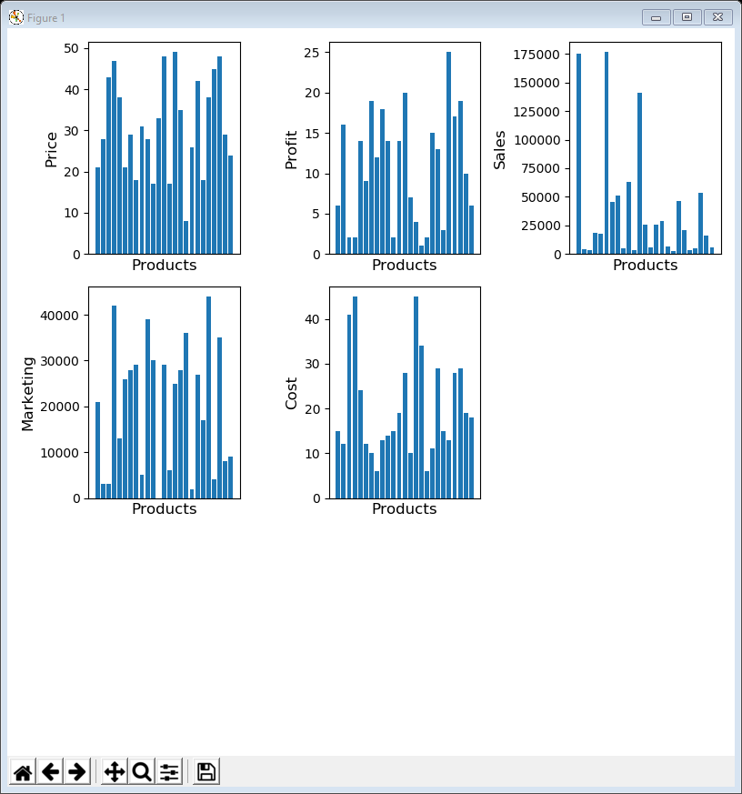
02BarChart all attributes subplots.py
Even using faceting / subplots doesn’t help illuminate the data
The variables all have different scales (e.g. £ per unit, units sold, total spend in £) and there are no obvious relationships
the challenge is to compare these effectively via visualisation
plt.figure(figsize=(8, 8))
counter = 1
x_pos = np.arange(len(summary_data.index))
for attribute in summary_data:
sub = plt.subplot(3, 3, counter)
sub.bar(x_pos, summary_data[attribute],
align='center')
sub.set_xticks([])
sub.set_xlabel('Products', fontsize=12)
sub.set_ylabel(attribute, fontsize=12)
counter += 1
plt.tight_layout()
plt.show()

Slide 7
Normalisation
The first thing to do is to normalise the data so that everything has the same scale
makes it much easier to compare
Normalisation has a number of different meanings in different contexts but here it means “scale all the values to lie between 0 and 1”
This is easy to achieve – just divide each variable by its maximum value
We could do this in place (so that summary_data was normalised) but here we create a new dataframe, normalised_data
normalised_data = summary_data / summary_data.max()
print(normalised_data.head())

Slide 8
03ComparativeBarChart high volume.py
One way to compare attributes is using a comparative bar chart which merges the 5 bar charts into one, giving each attribute a different colour
however with 5 attributes and 25 product that is going to result in 125 bars, which is far too many!
instead we segment and, for example, look at the high volume products, A, F & L
The code is a bit involved – we won’t consider in detail, since we will not use it again
selected = ['A', 'F', 'L'] # high volume
colours = ['b', 'g', 'r', 'c', 'm', 'y', 'k']
plt.figure(figsize=(8, 8))
c = 0
n_bars = len(selected)
x_pos_base = np.arange(len(summary_data.columns))
bar_width = 0.8 / n_bars
for name in selected:
values = normalised_data.loc[[name]].values.flatten().tolist()
x_pos = [x + (bar_width * c) for x in x_pos_base]
plt.bar(x_pos, values, color=colours[c % len(colours)],
width=bar_width, edgecolor='white', label='Product ' + name)
c += 1
plt.yticks([0.2, 0.4, 0.6, 0.8, 1.0])
x_pos = [x + (bar_width * (c - 1) / 2) for x in x_pos_base]
plt.xticks(x_pos, summary_data.columns)
plt.legend()
plt.show()

Slide 9
03ComparativeBarChart high volume.py
helps understanding a little, e.g. …
maybe why it doesn’t sell as well as A & F
or maybe it’s because L is much more expensive
or maybe it’s nothing to do with marketing / price …
nothing spent on marketing product L

Slide 10
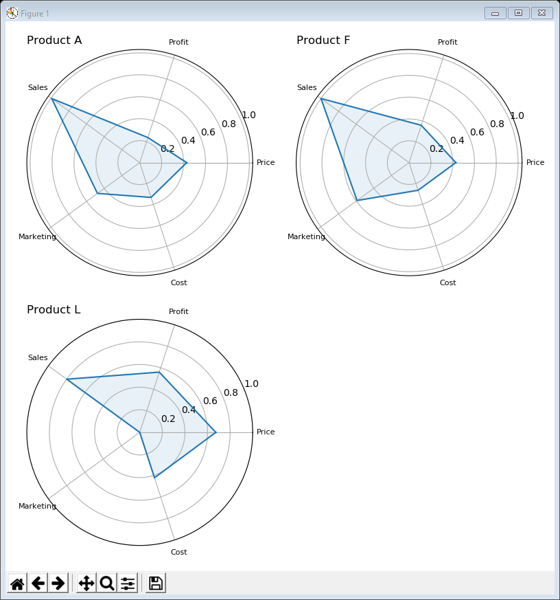
Radar / Spider plots
Another way to do to compare these 5 variables is via a radar plot
set the normalised variables out around a circle
plot the values (with the centre of the circle as 0 and the circumference as 1)
join the dots to create a shape
The variables’ order can be important; here:
positive measures that the company might want to maximise (profit & sales) are at the top
negative measures that the company might want to minimise (marketing & cost) are at the bottom
price is in the middle as it is neither
per unit values (profit, price & cost) are on the right
total measures (sales & marketing) are on the left
Arranging the variables like this means that we can easily identify more desirable shapes
i.e. those where most of the volume is at the top
Compare radar plots by faceting or overlaying

Slide 11
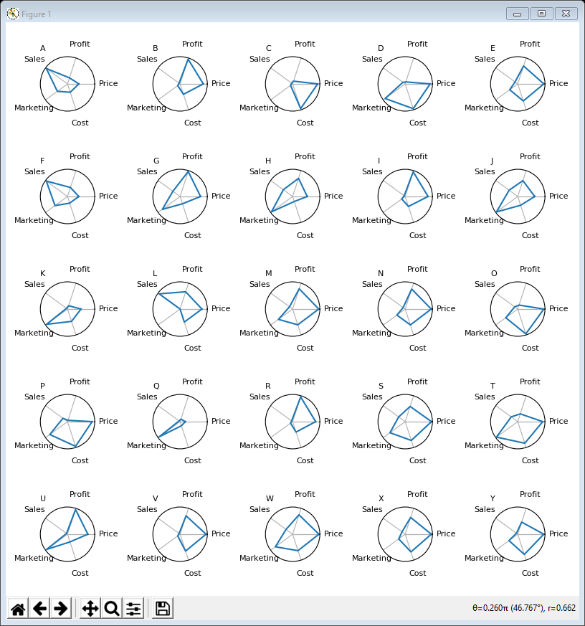
04RadarPlot all subplots.py
The following code creates radar subplots for all products
calculate a list of angles (with 5 variables each angles is 360 / 5 = 72)
calculate a list of values (with the first value added onto the end of the list so the line around the shape is joined up)
do a polar plot (i.e. circular) of values against angles
n_attributes = len(summary_data.columns)
angles = [n / float(n_attributes) * 2 * np.pi
for n in range(n_attributes + 1)]
plt.figure(figsize=(8, 8))
counter = 1
for name in normalised_data.index:
values = normalised_data.loc[[name]].values
.flatten().tolist()
values += values[:1]
sub = plt.subplot(5, 5, counter, polar=True)
sub.plot(angles, values)
sub.set_yticks([])
sub.set_xticks(angles)
sub.set_xticklabels(normalised_data.columns, fontsize=8)
sub.set_title(name, fontsize=8, loc='left')
counter += 1
plt.tight_layout()
plt.show()
reasonably easy to compare shapes
but a bit too much information

Slide 12
05RadarPlot high volume subplots.py
Restricting the previous code to high volume product just involves a few small changes
in this example the shapes are filled in (alpha refers to transparency)
we can also add y-ticks because there’s more space
angles = [n / float(len(summary_data.columns)) * 2 * np.pi
for n in range(len(summary_data.columns) + 1)]
plt.figure(figsize=(8, 8))
counter = 1
for name in selected:
values = normalised_data.loc[[name]].values
.flatten().tolist()
values += values[:1]
sub = plt.subplot(2, 2, counter, polar=True)
sub.plot(angles, values)
sub.fill(angles, values, alpha=0.1)
sub.set_yticks([0.2, 0.4, 0.6, 0.8, 1.0])
sub.set_xticks(angles)
sub.set_xticklabels(summary_data.columns, fontsize=8)
sub.set_title('Product ' + name, fontsize=12, loc='left')
counter += 1
plt.tight_layout()
plt.show()

Slide 13
06RadarPlot high volume overlaid.py
Another common way of comparing radar plots is to overlay them
most of the changes just involve colours
the other change is that we only create one plot rather than a new one each time around the loop (strictly speaking don’t need subplots at all – just left in to make comparison easier)
n_attributes = len(summary_data.columns)
angles = [n / float(n_attributes) * 2 * np.pi for n in range(n_attributes + 1)]
colours = ['b', 'g', 'r']
c = 0
plt.figure(figsize=(6, 6))
sub = plt.subplot(1, 1, 1, polar=True)
for name in selected:
values = normalised_data.loc[[name]].values.flatten().tolist()
values += values[:1]
sub.plot(angles, values, colours[c % len(colours)], label='Product ' + name)
sub.fill(angles, values, colours[c % len(colours)], alpha=0.1)
sub.set_yticks([0.2, 0.4, 0.6, 0.8, 1.0])
sub.set_xticks(angles)
sub.set_xticklabels(summary_data.columns)
c += 1
plt.legend(loc=1)
plt.show()

Slide 14
06RadarPlot high volume overlaid.py
L looks more attractive here … lower sales than A & F, but higher profit per unit
so may be worth spending some money on marketing L

Slide 15
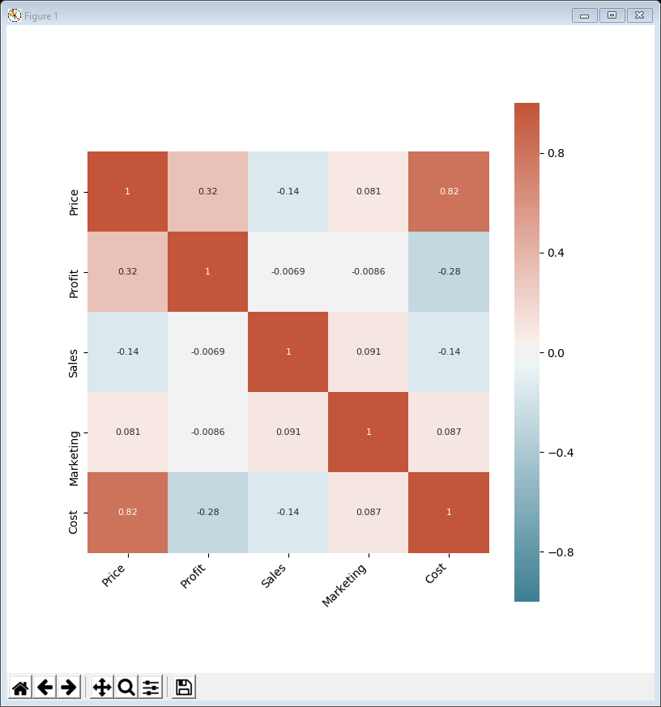
Correlogram / Pair Plot
We already know that the only closely correlated attributes are Price and Cost
in Lecture 04, example 12, we calculated a heat map of the correlations
But helpful to visualise the correlations
particularly to inform the bubble plots in the rest of the lecture
Previously we just calculated a load of correlations between time-series but didn’t arrange them logically
But we could arrange them to match the columns & rows in the heat map
For the diagonal just put a histogram of the variable’s distribution
no point in showing a correlation of a variable with itself)
This type of visualisation is known as a correlogram or pair plot

Slide 16
07Correlogram all attributes.py
It’s not too difficult to create a correlogram using MatPlotLib subplots … but it’s even easier using Seaborn
Seaborn does the whole thing for us, with a couple of adjustments
height=1.5 controls the height of each plot and thus the overall size of the figure
plot_kws={'s': 20} controls the size of the dots
import seaborn as sns
... # read in the data and set up summary_data
sns.pairplot(summary_data, height=1.5, plot_kws={'s': 20})
plt.show()

Slide 17
07Correlogram all attributes.py
can see the correlation between Price & Cost
can see the correlation between Price & Cost

Slide 18
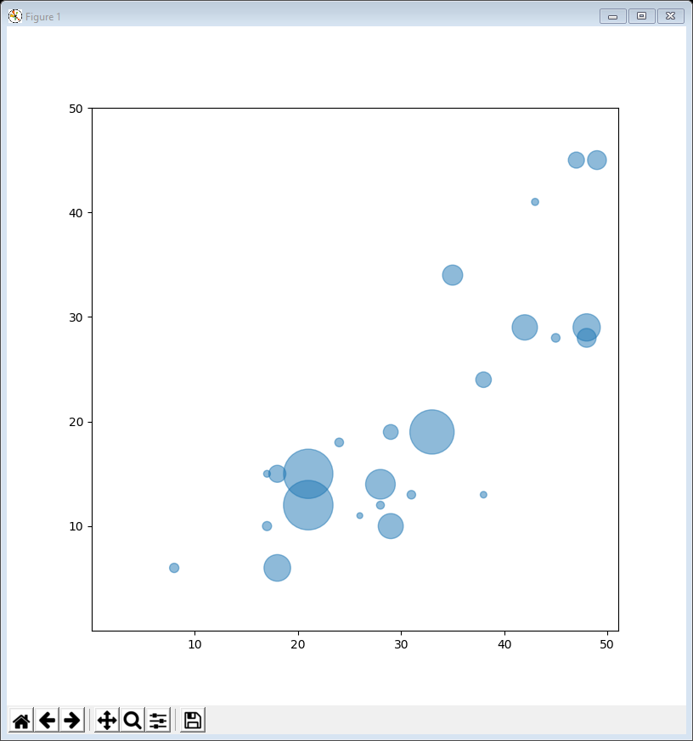
Bubble plots
Although we know there is little correlation in this dataset, individual values for one variable can still impact on other variables
want to visualise this if at all possible but can’t really visualise 5 dimensions
However a common way of visualising 3 dimensions is by using a bubble plot (like an enhanced scatter plot)
choose 2 of the 3 variables to plot along the x and y axes (standard scatter plot)
make the sizes of the dots proportional to the values of the 3rd variable – these are the bubbles
So a bubble plot of variables U vs V vs W will have the bubbles in the same position as a scatter plot of U vs V but with bubble size governed by W

Slide 19
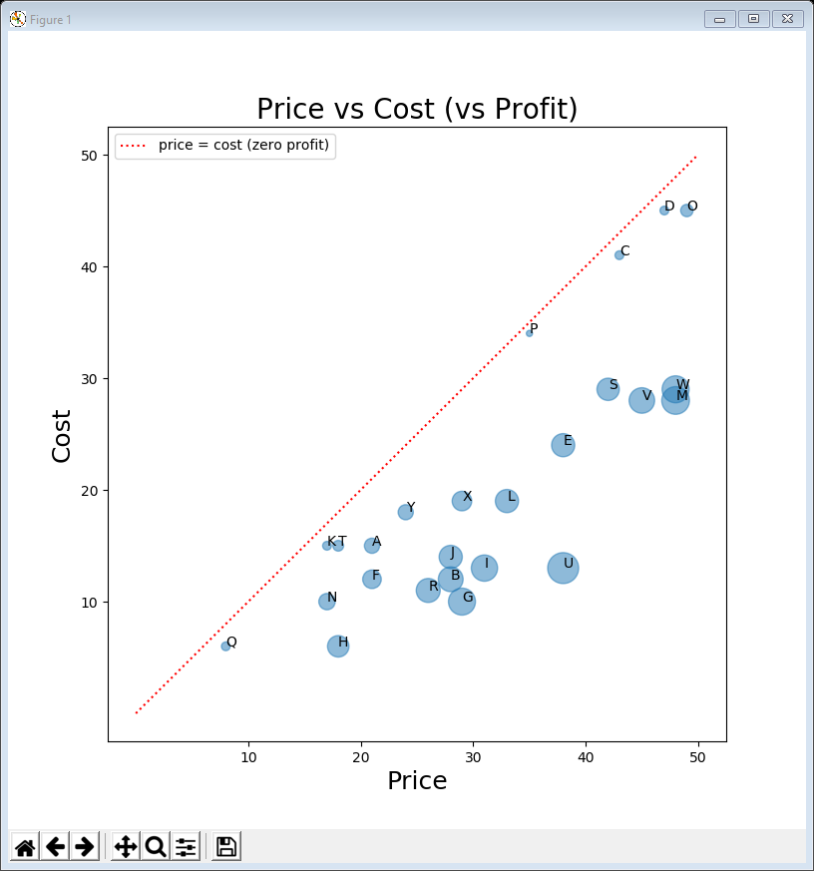
08BubblePlot price cost profit.py
First we plot price vs cost vs profit (i.e. the scatter plot we have already seen with bubble size determined by profit)
bubble size is set here – the scaling value 20 is set by trial and error
the plot is created with scatter() but also setting bubble size and transparency
the bubbles are all labelled (see outlier examples last week)
we add a line showing where price = cost (i.e. zero profit)
summary_data['BubbleSize'] = summary_data['Profit'] * 20
plt.figure(figsize=(8, 8))
plt.scatter(summary_data['Price'], summary_data['Cost'],
s=summary_data['BubbleSize'], alpha=0.5)
plt.xticks([10, 20, 30, 40, 50])
plt.yticks([10, 20, 30, 40, 50])
plt.title('Price vs Cost (vs Profit)', fontsize=20)
plt.xlabel('Price', fontsize=18)
plt.ylabel('Cost', fontsize=18)
for i, name in enumerate(summary_data.index):
plt.annotate(name, (summary_data['Price'][i], summary_data['Cost'][i]))
plt.plot([0, 50], [0, 50], linestyle=':', color='r',
label='price = cost (zero profit)')
plt.legend(loc=2)
plt.show()

Slide 20
Observations
Everything is to the right of the line
if a product was to the left that would indicate cost is greater than the price (i.e. negative profit – not impossible, e.g. for loss leaders, but unlikely)
Do you notice something about the bubble sizes?
they get bigger the further away from the line they are … what does this mean?
In fact this is inevitable – for any fixed cost, moving to the right is equivalent to increasing the price
because profit = price – cost … so inevitably, for a fixed cost, the profit must increase as the price increases
This is actually a result of the fact that profit, price & cost are co-dependent
if you know any two of them, you can calculate the third

Slide 21
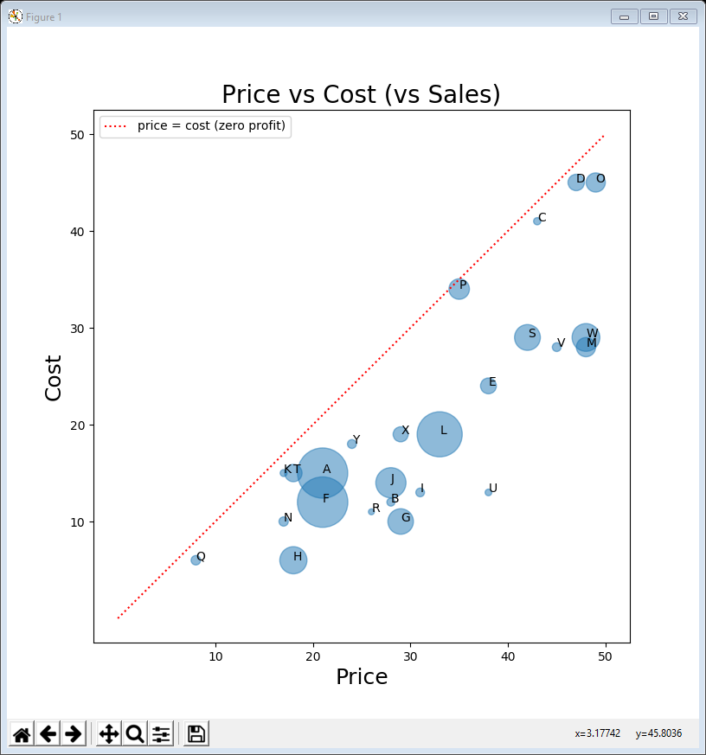
09BubblePlot price cost sales.py
Let’s try plotting price vs cost vs sales (same positions as before, but different bubble sizes)
bubble scaling is very different (0.01 as compared with 20) but other than that the code is virtually identical
summary_data['BubbleSize'] = summary_data['Sales'] * 0.01
plt.figure(figsize=(8, 8))
plt.scatter(summary_data['Price'], summary_data['Cost'],
s=summary_data['BubbleSize'], alpha=0.5)
plt.xticks([10, 20, 30, 40, 50])
plt.yticks([10, 20, 30, 40, 50])
plt.title('Price vs Cost (vs Sales)', fontsize=20)
plt.xlabel('Price', fontsize=18)
plt.ylabel('Cost', fontsize=18)
for i, name in enumerate(summary_data.index):
plt.annotate(name, (summary_data['Price'][i], summary_data['Cost'][i]))
plt.plot([0, 50], [0, 50], linestyle=':', color='r',
label='price = cost (zero profit)')
plt.legend(loc=2)
plt.show()

Slide 22
Observations
No observable pattern to the bubble sizes
However, remember that the further away (horizontally) that a bubble is from the line, the higher the profit per unit
So although U has a tiny bubble size (low sales), it’s one of the most profitable items

Slide 23
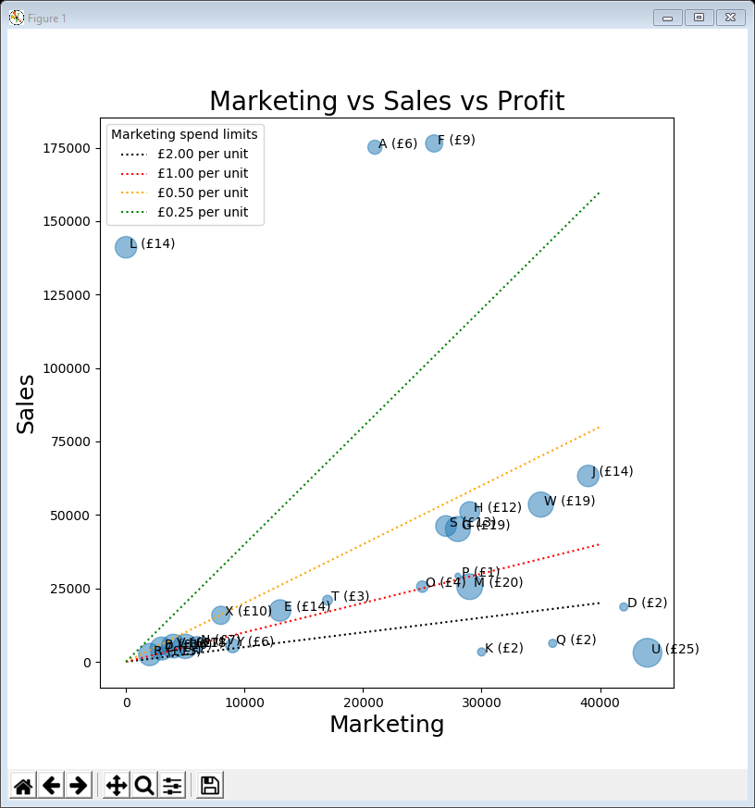
10BubblePlot marketing sales profit.py
Returning to the scatter plot from the end of last week’s lecture (marketing vs sales) let’s put bubble sizes showing the profit
the code is essentially the same with adjustments to the variables chosen, the bubble scaling and the labelling
summary_data['BubbleSize'] = summary_data['Profit'] * 20
plt.figure(figsize=(8, 8))
plt.scatter(summary_data['Marketing'], summary_data['Sales'],
s=summary_data['BubbleSize'], alpha=0.5)
plt.title('Marketing vs Sales vs Profit', fontsize=20)
plt.xlabel('Marketing', fontsize=18)
plt.ylabel('Sales', fontsize=18)
for i, name in enumerate(summary_data.index):
plt.annotate(name + ' (£' + str(int(summary_data['Profit'][i])) + ')',
(summary_data['Marketing'][i] + 300, summary_data['Sales'][i]))
... # plot the marketing spend limit lines here
plt.show()

Slide 24
Observations
Previously we identified that D, K, Q & U had more than £2 per unit sold spend on marketing
However, now we can see that since U sells for such a huge profit (£25 per unit!!) it’s probably OK to spend more on marketing it
It does bring up the question – for each unit sold, how much is spent on marketing?

Slide 25
Advertising
Let’s add another column to the summary dataframe called Advertising
calculated as the marketing spend divided by the total sales for a product
Essentially Advertising is the marketing per unit
although if the number of sales change in the future, this value will also change, even if the marketing spend stays the same
summary_data['Advertising'] = summary_data['Marketing'] / summary_data['Sales']

Slide 26
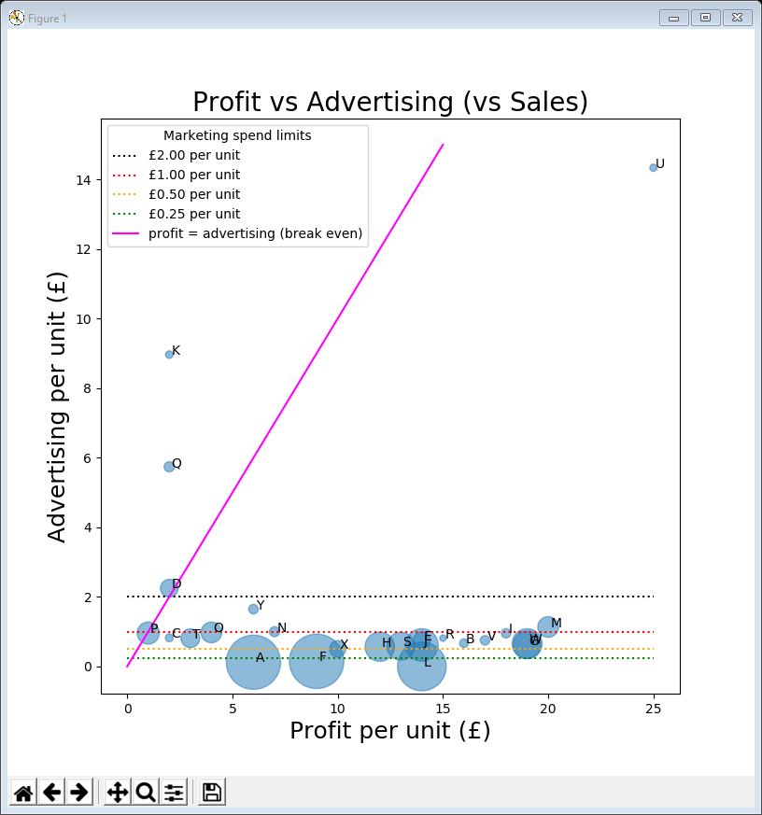
11BubblePlot profit advertising sales.py
Now let’s plot profit vs advertising vs sales
the code is essentially the same with adjustments to the variables chosen
the spend limit lines are now horizontal (representing marketing per unit)
also add a diagonal (magenta) representing the profit / advertising break even
summary_data['BubbleSize'] = summary_data['Sales'] * 0.01
plt.figure(figsize=(8, 8))
plt.scatter(summary_data['Profit'], summary_data['Advertising'],
s=summary_data['BubbleSize'], alpha=0.5)
plt.title('Profit vs Advertising (vs Sales)', fontsize=20)
plt.xlabel('Profit per unit (£)', fontsize=18)
plt.ylabel('Advertising per unit (£)', fontsize=18)
for i, name in enumerate(summary_data.index):
plt.annotate(name, (summary_data['Profit'][i] + 0.1,
summary_data['Advertising'][i]))
plt.plot([0, 25], [2, 2], linestyle=':', color='black', label='£2.00 per unit')
plt.plot([0, 25], [1, 1], linestyle=':', color='red', label='£1.00 per unit')
plt.plot([0, 25], [0.5, 0.5], linestyle=':', color='orange', label='£0.50 per unit')
plt.plot([0, 25], [0.25, 0.25], linestyle=':', color='green', label='£0.25 per unit')
plt.plot([0, 15], [0, 15], color='magenta', label='profit = advertising (break even)')
plt.legend(loc=2, title='Marketing spend limits')
plt.show()

Slide 27
Observations
For anything above the break even line (D, K, Q and possibly P), more money is being spent on advertising than is being made in profit
these products are making a loss overall!
However, although U has the highest advertising spend it is comfortably making a profit overall

Slide 28
12BubblePlot profit advertising sales log scale.py
On the previous plot most of the bubbles are clustered at the bottom
can space them better by using a logarithmic scale on the y-axis
the code is almost exactly the same
the log scale is set here
the profit / advertising break even has to be adjusted (the previous version just joined up the two end points, but that doesn’t work here since the line is now curved in log space)
the high volume products have dropped off the bottom – negative log values
plt.figure(figsize=(8, 8))
plt.scatter(summary_data['Profit'], summary_data['Advertising'],
s=summary_data['BubbleSize'], alpha=0.5)
plt.yscale('log')
plt.title('Profit vs Advertising (vs Sales)', fontsize=20)
plt.xlabel('Profit per unit (£)', fontsize=18)
plt.ylabel('Advertising per unit (£)', fontsize=18)
for i, name in enumerate(summary_data.index):
plt.annotate(name, (summary_data['Profit'][i] + 0.1,
summary_data['Advertising'][i]))
... # advertising spend limit lines drawn here
break_even = [x for x in range(25)]
plt.plot(break_even, break_even, linestyle='-', color='magenta',
label='profit = marketing (break even)')
plt.legend(loc=2, title='Advertising spend limits')
plt.show()

Slide 29
Data conclusions
Reminder - we are not making business recommendations
let the business analyst decide what to do
However …
can compare more than two variables in a variety of ways
some products (D, K & Q) are making a loss when marketing is taken into account
some products could have higher marketing spend (e.g. L & U)

Slide 30
Lecture summary
Looked at visualising datasets with higher dimensions
comparative bar charts
radar plots
correlograms
bubble plots
More techniques for the toolbox
but not always obvious which to use or which variables to compare
need to apply some reasoning
can be more of an art than a science

